Slide 1
Is Programming Knowledge Related To Age? An Exploration of Stack Overflow
Patrick Morrison and Emerson Murphy-Hill
Department of Computer Science
North Carolina State University
{pjmorris, emurph} @ncsu.edu

Slide 2
"We know that older people have more experience and better judgment, but younger people seem more likely to have used specific technologies we're using, and we like people who can hit the ground running.”
- http://programmers.stackexchange.com/questions/370/how-old-is-too-old

Slide 3
"There's no inherent "Too Old," just perceptions on the part
of the interviewers."
- http://programmers.stackexchange.com/questions/370/how-old-is-too-old

Slide 4
“Basically it says that the Valley prefers younger candidates who will put in allnighters for lower wages, and advocates that experienced programmers move into management positions after they hit a certain age.”
- http://programmers.stackexchange.com/questions/370/how-old-is-too-old
Notes:
Any given week on HN or Reddit, there’s likely to be a discussion around age, ageism and programming

Slide 5
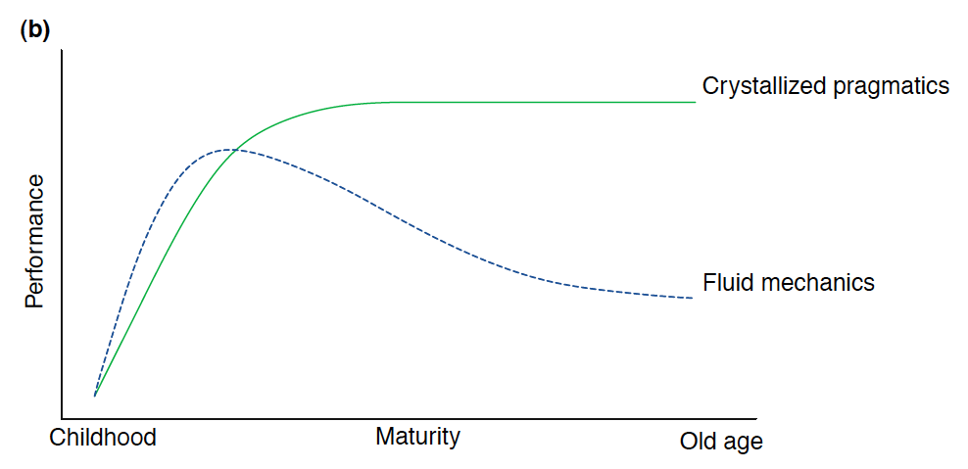
Cognitive Psychology suggests…
F. I. M. Craik and E. Bialystok, “Cognition through the lifespan: mechanisms of change,” Trends in Cognitive Sciences, vol. 10,no. 3, pp. 131 – 138, 2006.

Slide 6
Research Questions
RQ1: Does age have a positive effect on programming knowledge?
RQ2: Do older programmers possess a wider variety of technologies and skills?
RQ3: To what degree do older programmers learn new technologies?

Slide 7
Stack Overflow Data
~1.6 Million users, ~300K with ages
Selected:
ages 15-70
2012 question answerers
Reputations between 2-100,000
Sample: 84,284 users
age: mean 29.02, sd 7.0
reputation: mean 1073.9, sd 3975.2

Slide 8
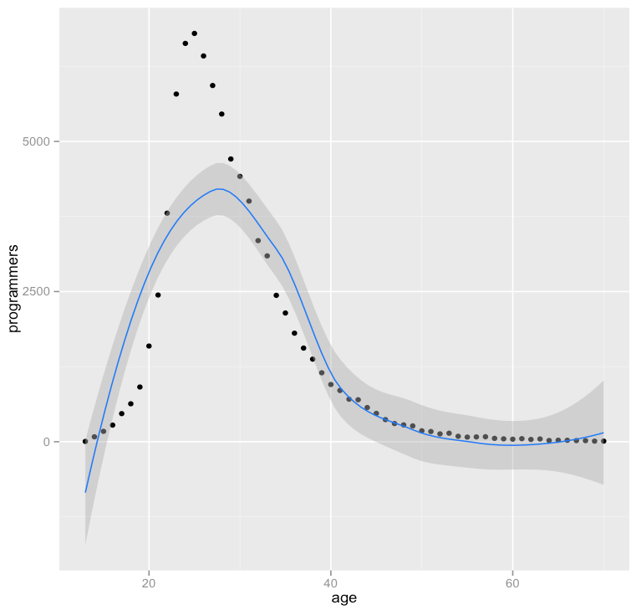
84,284 users
mean age 29.02, sd 7.0

Slide 9
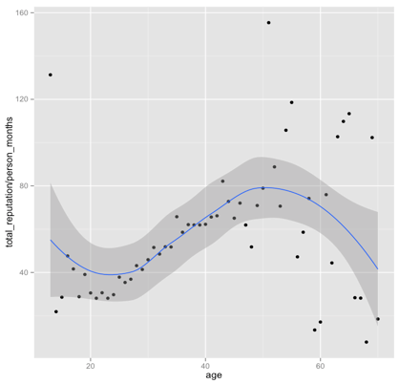
RQ1: Age -> Knowledge? Yes.

Slide 10
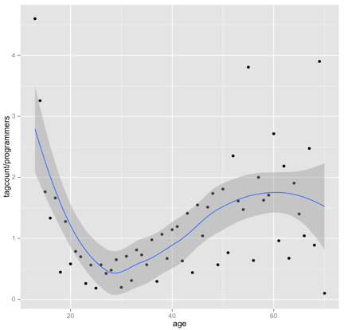
RQ2: Age -> Wider skills? Mixed.

Slide 11
RQ3: Age -> Newer skills? Yes.
tag | younger | older | p-value | difference
clojure | 3.25 | 2.95 | 0.802 | -0.30
django | 0.91 | 0.91 | 0.49 | 0.00
git | 1.82 | 1.78 | 0.62 | -0.04
ios | 0.96 | 1.25 | 0.00000887 | 0.29
jquery | 0.78 | 0.79 | 0.358 | 0.01
ruby-on-rails | 0.89 | 0.93 | 0.3 | 0.04
silverlight | 0.63 | 0.69 | 0.29 | 0.06
windows-phone-7 | 0.68 | 1.16 | 0.0004 | 0.48
Notes:
We split the sample in to younger and older groups, where the dividing line is the mean + one standard deviation. This put the cutoff at 36. younger <= 36, older 37 and up
We then ran a t-test on average question score for 10 ‘new’ tags. The only statistically significant differences were for ios and windows-phone-7, where the older programmers had higher average scores. (We probably should’ve used a Mann-Whitney or other non parametric test_

Slide 12
Sampler of web reactions
IEEE Spectrum: “Dandy”
Reddit: “Obvious”
Hacker News: “Meaningless”
What’s yours?

Slide 13
Summary
Age is positively correlated with SO reputation
Mid-range programmers appear to focus on fewer technologies
(Some) old dogs learn (some) new tricks

Slide 14
The Other Summary
“Young men make wars, and the virtues of war are the virtues of young men. Courage and hope for the future.
Then old men make the peace. And the vices of peace are the vices of old men. Mistrust and caution. It must be so.”
– Prince Feisal (aka Obi-Wan Kenobi aka Alec Guiness), “Lawrence of Arabia”
Notes:
Maybe there’s a place for everyone?

