Slide 1
Improving Bug Localization using Correlations in Crash Reports
David (Shaohua) Wang, Foutse Khomh, Ying Zou

Slide 2
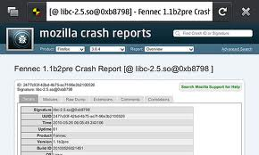
Mozilla Firefox receives 2.5 million crash reports every day!
Crash reports analysis for localizing bugs is a challenging task.
Notes:
Crash reports are

Slide 3
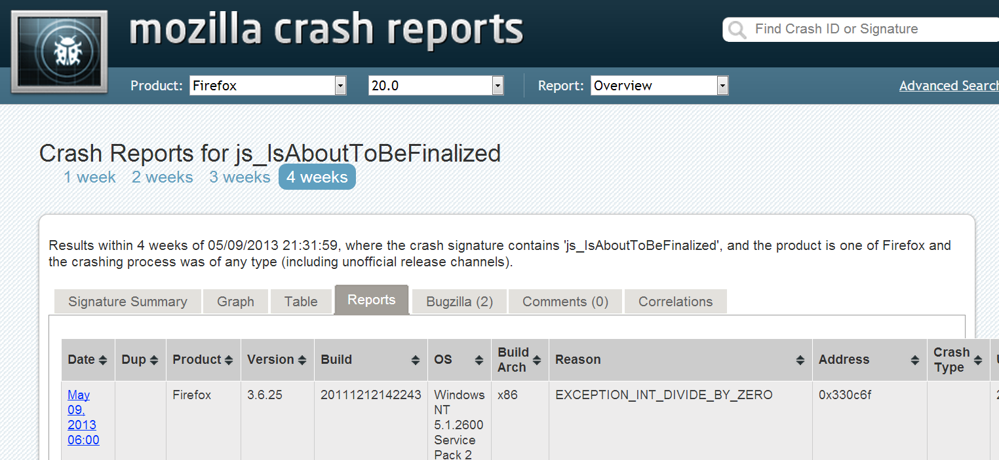
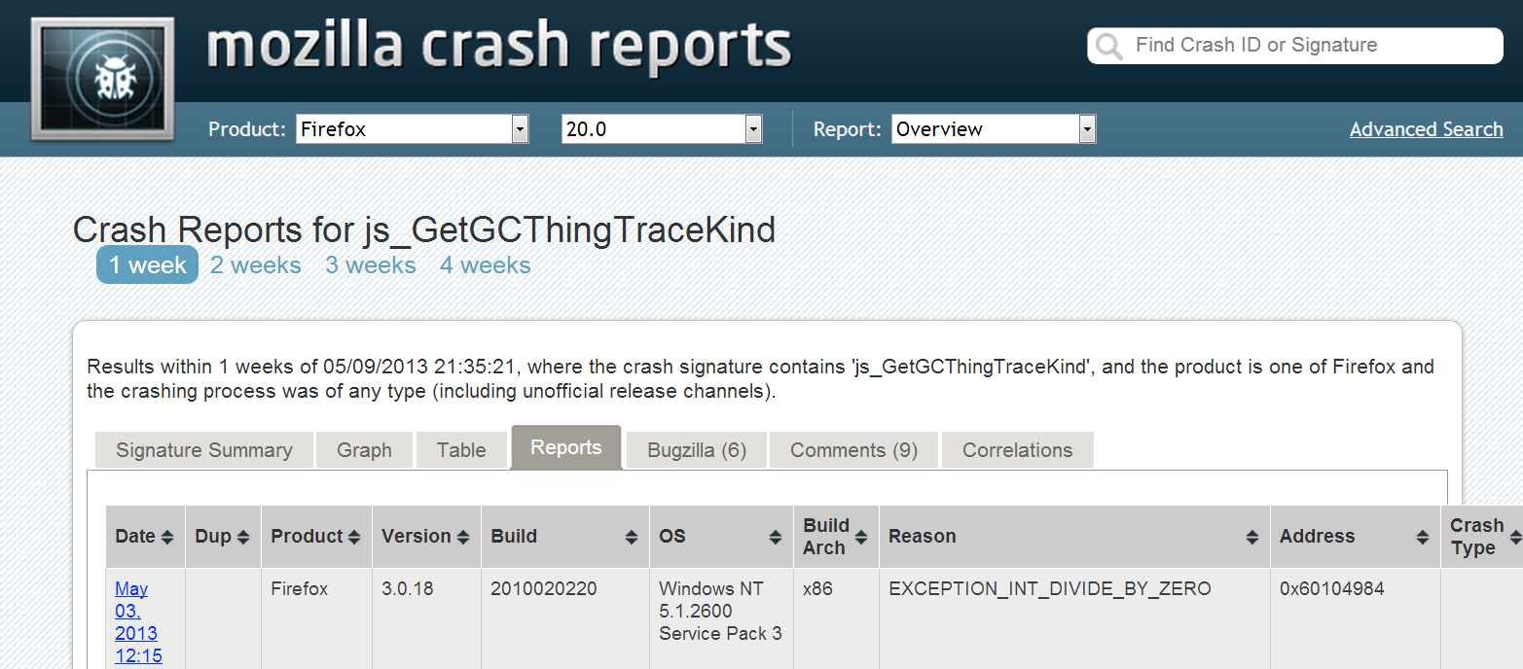
Related by bug id 514819
Crashes appear in different forms, however they may be correlated.
Notes:
Software crashes may be caused by the same bug(s) or correlated bugs.

Slide 4
We Investigate
How to identify correlated crashes automatically?
How to leverage correlations between crash reports to improve bug fixing?
Notes:
Study crash signature and stack traces
Rank buggy files

Slide 5
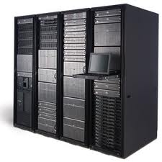
Mozilla Crash Reporting System
Crash Type
Collected
Sent
Crash Type
Grouped based on crash signatures
Assign
Notes:
Crash Reports collected and sent to server automatically

Slide 6
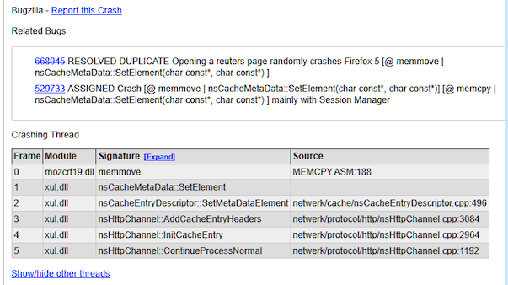
Firefox Stack Trace
Crash Signature
Method Name
Top Frame
File Name
Parameter
Memory
radhslib.dll@0X3b6f | nsHttpConnection:: OnWriteSegment(char const)

Slide 7
Crash Correlation Group
js_GetGCThingTraceKind
Bug ID 514819
js_IsAboutToBeFinalized
Bug ID 572011
nsDiskCacheStreamIO::FlushBufferToFile()
Strstr|nsDiskCacheStreamIO::FlushBufferToFile()
Notes:
A group of crash types are assigned with identical or correlated bugs
A crash type can belong to one or several CCGs
Crash Correlation Groups offer a diversity of crashing scenarios helping developers identify the root cause of bugs more efficiently

Slide 8
Data Collection
Examined 1628 bug reports related to 1,256 crashes
Sampled 66,208 crash reports
Parsed 213,000 bug reports
Obtained 29,874 stack traces

Slide 9
Research Questions
RQ1: Can an analysis of crash signature help identify correlated crashes?
RQ2: Can a detailed analysis of stack traces improve the identification of correlated crashes?
RQ3: Can an analysis of correlated crash types help identify buggy files?

Slide 10
[Rule1] Crash Signature Comparison
nsDiskCacheStreamIO::FlushBufferToFile()
Strstr|nsDiskCacheStreamIO::FlushBufferToFile()
nsStyleContext::Release()
nsStyleContext::nsStyleContext
Notes:
Compare the strings of crash signatures of two crash types to decide if they are correlated

Slide 11
[Rule 1] Results
 | Firefox
Precision | 100%
Recall | 68%
All the crash correlation groups retrieved using the proposed rule are correct

Slide 12
Research Questions
RQ1: Can an analysis of crash signature help identify correlated crashes?
RQ2: Can a detailed analysis of stack traces improve the identification of correlated crashes?
RQ3: Can an analysis of correlated crash types help identify buggy files?

Slide 13
[Rule2] Top Frame Comparison
A Crash Report of Crash A
Frame | Method Signature | Source code path
F1 | Method | Source
…
A Crash Report of Crash B
Identical
Correlated
Frame | Method Signature | Source code path
F1 | Method | Source
…
Notes:
Compare the top frames of two crashes to verify if they are correlated

Slide 14
[Rule3] Frequent Closed Ordered Sub-set Comparison
Two crashes are correlated if they have one or more identical Frequent closed ordered sub-sets of frames of stack traces from crashes.
Notes:
Compare frequent closed ordered sub-sets of frames of stack traces(FCSFs) from crashes

Slide 15
[Rule3] Frequent Closed Ordered Sub-set Comparison
A Crash
Report1
A
B
C
D
E
F
Report3
B
D
E
F
Report2
D
E
F
A
Identical and longest
Frequent Closed Ordered Sub-set of Frames

Slide 16
Results of RQ2
Precision
Number of Crash Reports
# of crash reports has no impact on precision

Slide 17
Results of RQ2
Recall
Increased!
Number of Crash Reports
The detailed stack traces analysis can help[Rule1] identify more correlated crashes

Slide 18
Research Questions
RQ1: Can an analysis of crash signature help identify correlated crashes?
RQ2: Can a detailed analysis of stack traces improve the identification of correlated crashes?
RQ3: Can an analysis of correlated crash types help identify buggy files?

Slide 19
RQ3: Can an analysis of correlated crashes help identify buggy files?
Extract features from files shown in a crash correlation group
Create feature vectors for each file
Train Bayesian Belief Networks models with training data
Rank the suspicious buggy files
Notes:
Observe that buggy files are in the common stack traces of the crashes in a correlation crash group
Rank suspicious buggy files using Bayesian Belief Networks , reducing the effort required to examine the files

Slide 20
Results of RQ3
Precision
Size of the Training Corpus
Precision improved with the increase of the size of training corpus

Slide 21
Results of RQ3
Recall
Size of the Training Corpus
Recall improved with increase of the size of training corpus

Slide 22
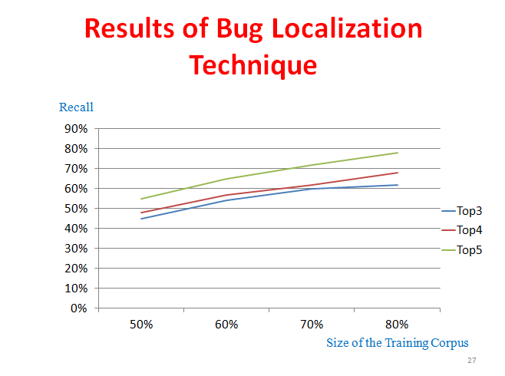

Slide 23
Backup

Slide 24
Crash Reporting
Crash Reports collected and sent to server automatically
Crash Reports grouped based on crash signatures- Crash Type
Crash Types assigned with bug reports

Slide 25
Notes:
have a slide with all the rules and then one slide with results of the detection of crash correlation and another with the results of fault localization.

Slide 26
Three Rules
[Rule1] Crash Signature Comparison
[Rule2] Top Frame Comparison
[Rule3] Frequent Closed Ordered Sub-set Comparison

Slide 27
Results of Our Rules
[Rule1] All the crash correlation groups retrieved using the proposed rule are correct on Firefox.
[Rule2 and Rule 3] The detailed stack traces analysis can help [Rule1] identify more correlated crashes.

Slide 28
Results of Bug Localization Technique
Recall
Size of the Training Corpus

Slide 29
References
Slide 1 pictures:
Crash reports pictures: http:// blog.mozilla.com/webdev/2010/05/ 19/socorro-mozilla-crash-reports/
Hard working Picture is from http://www.redtutorials.com/2011/08/individual-studies/working-hard/
Crash Reports Pictures: from http://lorelle.wordpress.com/2011/07/12/firefox-5-crashes-what-is-causing-them-and-how-to-fix-it/firefox-crash-report-details-related-bugs-crashing-thread/
Slide 2 pictures: All pictures are snapshots from https://crash-stats.mozilla.com/products/Firefox
Slide 4 pictures: http://www.zazzle.ca/cartoon_ladybugs_pattern_post_card-239343387817901112

